Slide 1
BEAM Update - Sep 2019
By David Miller

Slide 2
Progress
Model + Software Package
Laser Power Estimate
Thermal Image Scaling
Future Plans

Slide 3
Modelling
Radiative Heat
Temperature
Power Density
Laser Power
Qr
T
I
P
Treating each pixel as a separate region of space
Thermal Camera Footage
Laser power is spread over a certain region

Slide 4
Modelling
Thermal camera -> Temperature (K) -> Power Density (W/m2)
Packaged as a Python Package
License TBD
Four modules:
Model : Reading in and processing data
Materials : Modelling material performance
Experimental : Other methods investigated
beamwritetohdf5 : Write data to a structured HDF5 file

Slide 5
Modelling
Data is packaged in HDF5 files.
Designed to handle large volumes of data
Supports collections of datasets of different sizes
Supported multi-dimensional data
Structure for storing all information regarding a product
Utility functions for simplify writing according to this structure

Slide 6
File
Runs
{1…}
Predictions
Data
r
P
T
Tp
I
Laser
Camera
x
y
z
t
T
vel
Pi
Qr

Slide 7
Modelling
Materials are defined in a config file
Set of reference points for parameters and temperature ranges
Builds functions around the points
Modelling functions use these functions

Slide 8
Modelling
[SS-316L]
; thermal conductivity values
K = [16.3,15.45,21.5]
; temperature ranges for each thermal conductivity value
K_T = [[0,20],[20,100],[100,500]]
; specific heat capacity values
C = [450.0,492.5,500.0]
; temperature ranges for each thermal specific heat capacity value
C_T = [[0,20],[20,93],[93,100]]
...

Slide 9
Modelling
import LBAMMaterials.LBAMMaterials as mat
import LBAMModel.LBAMModel as model
import WriteDataToHPF5.beamwritedatatohdf5 as hd
## Setup variables and material parameters
# temperature of the space where the data was recorded in Kelvin
T0 = mat.CelciusToK(23.0)
# Create the data and objects for stainless steel 316L
# e : emissivity of the chosen material
# K : Spline function for thermal conductivity
# D : Spline function for thermal diffusivity
e,K,D = mat.buildMaterialData("SS-316L")

Slide 10
Modelling
# Read in and process the thermal camera footage
Qr = model.readH264("video.h264")
# Read in and process xml log file
xml_data = model.readXMLData(“xml-log.xml”)
# Predict the temperature based off the thermal camera data
T = model.predictTemperature(Qr,e,T0,vectorize=True)
# Predict the power density based off the predicted temperature
I = model.predictPowerDensity(T,K,D)
# Predict laser power
P = model.predictPower(I)

Slide 11
Modelling
# Create and write data to file adding it to a new run group
with hd.initialize(“run-data.hdf5”) as data_f:
hd.updateData(data_f, # file object
createNew=True, # flag to create new run group
# data to add
Qr=Qr,T=T,I=I,P=P,xml=xml_data)

Slide 12
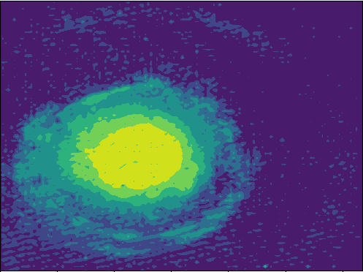
Laser Power
Identifying boundary from thermal images
Current best from Hough Circle Transform (80%)
Searching for ways to clean up the data
A good power estimate is need to predict the melt pool

Slide 13
Laser Power
Current methods being investigated:
Edge detection
Apply edge detection algorithm
Clean up/denoise etc.
Pass data onto Hough Circle
Wavelet denoising
Fitting functions to predict the ideal Hough Circle
Collecting data about the ideal Hough Circle
Fitting functions (e.g. KDE) to the data
Using the functions to predict the ideal Hough Circle.
Non-linear means denoising

Slide 14
Image Scaling
Upscaling low resolution thermal images whilst maintaining data quality
Getting good quality data from cheap IoT solutions
Recording data on a Raspberry Pi
Scale it to a higher resolution
Retrieve higher resolution thermal data

Slide 15
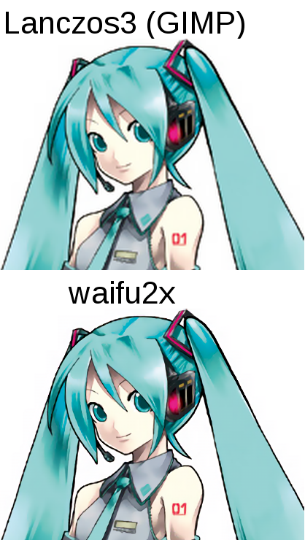
Image Scaling
Waifu2x
Image Super-Resolution for Anime-style art using Deep Convolutional Neural Networks (2015), Dong et al.
Scales and denosies images
Referenced in other papers
Used in other industries
Caffe ML
Available pre-trained
8 different datasets
Source: https://github.com/nagadomi/waifu2x,
DOA: 26/09/2019

Slide 16
Image Scaling
Data
Normalize to
[0,1]
Saved as Image
Waifu2x
Scale to original temperature limits
Normalize to
[0,1]
Read in result
Scaled Data

Slide 17
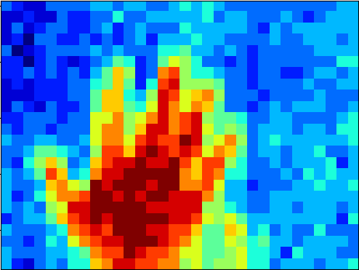
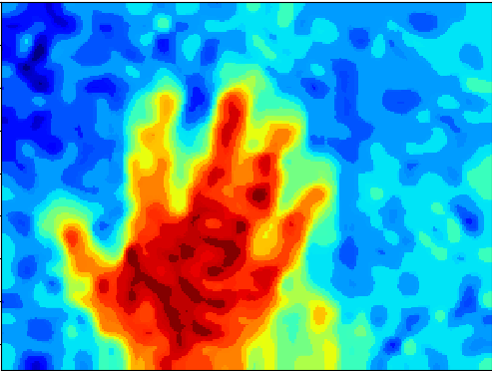
Image Scaling
Original (float64)
Anime Style Art RGB, Scaled 9x

Slide 18
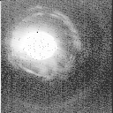
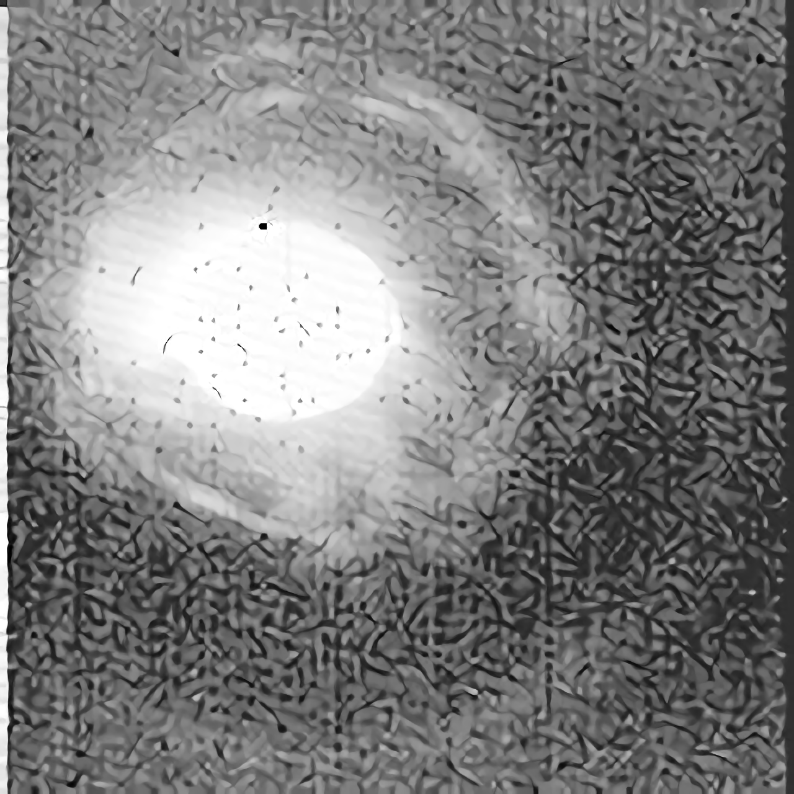
Image Scaling
Original (uint8)
Anime Style Art, Scaled 10x

Slide 19

Image Scaling
Original (uint8)
Anime Style Art, Denoised 2

Slide 20
Image Scaling
For each model :
For each image data type:
Scaling/denoise the data for different factors
Scaling 2x to 10x
Denoising 0 to 2 factor
Datasets used:
Arrow Shape
Raspberry Pi dataset
60 secs of hand gestures

Slide 21
Image Scaling
Results are compared to the original by the following:
Difference in maximum temperatures
Difference in minimum temperatures
Difference in temperature range
Difference in temperature variance
Variance in the above values
Could be used to retrain the model

Slide 22
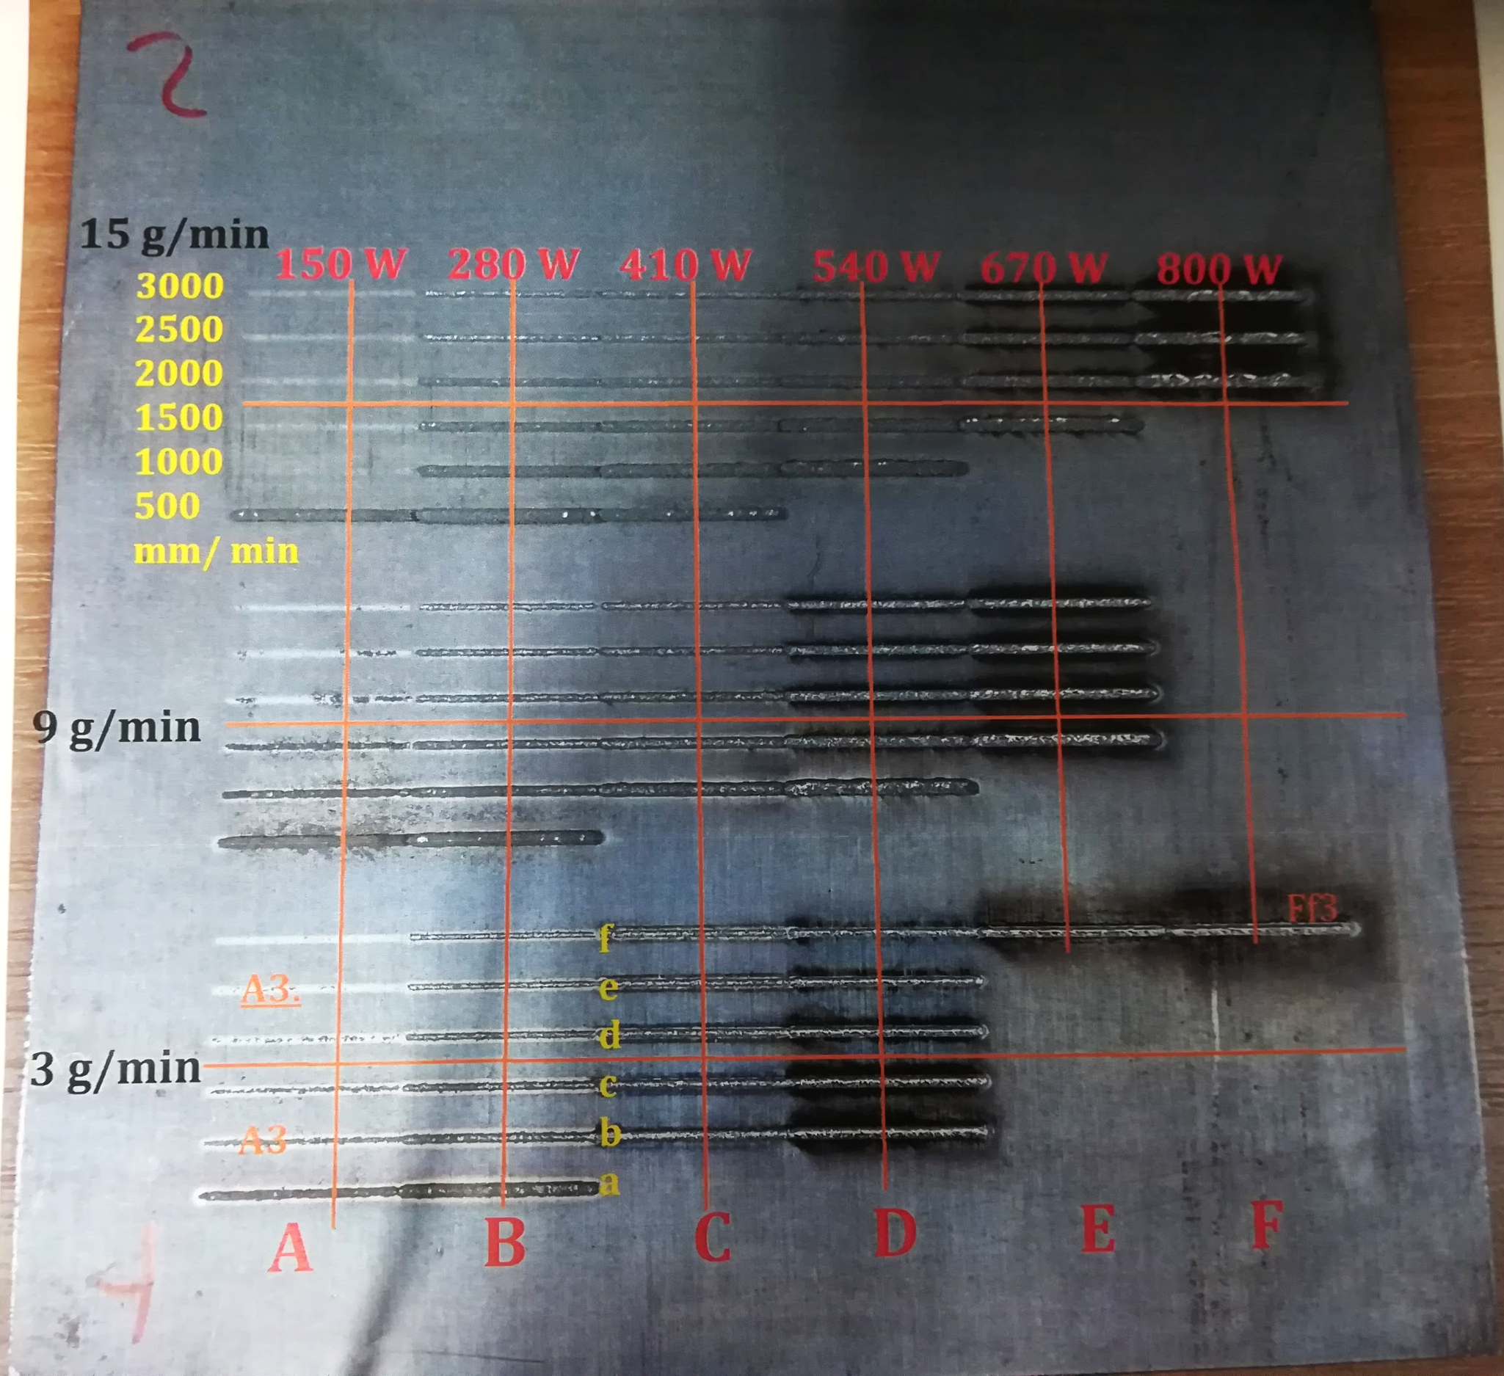
Future Plans

Slide 23
Future Plans
Record thermal data using a Raspberry Pi and a cheap thermal camera
Custom case being built
Attaches near the base plate
Records thermal data from a different angle
If it can safely collect data, other sensors could be added
Continue to investigate power estimate methods

Slide 24
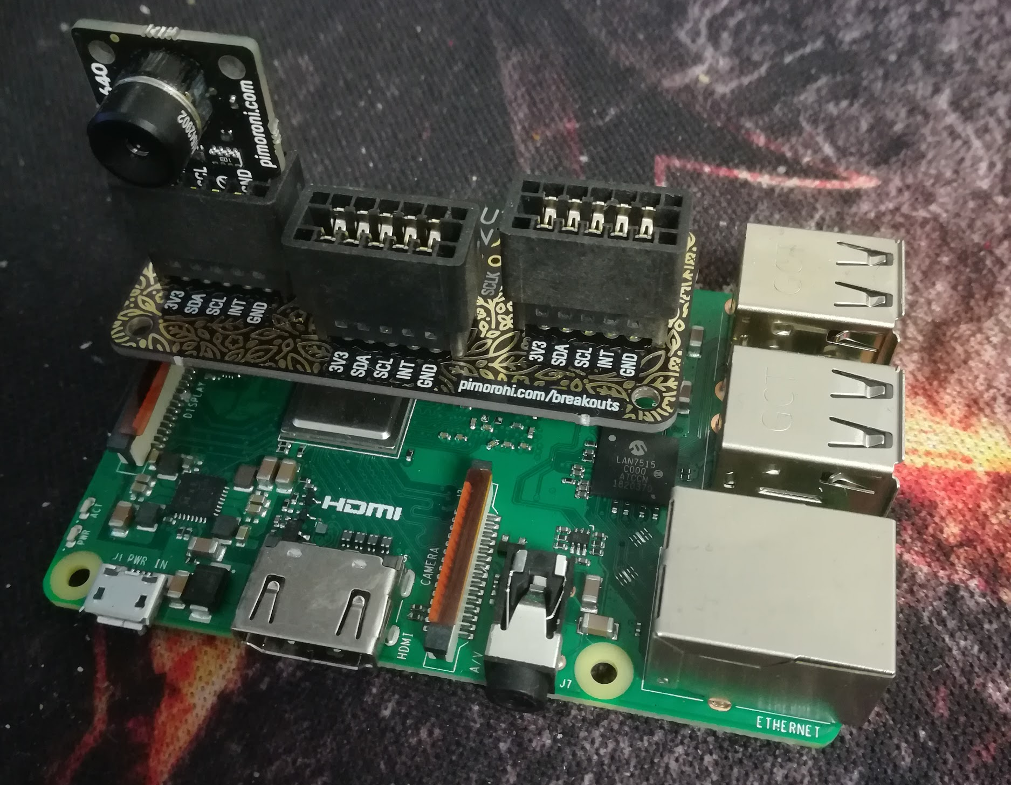
Future Plans
MLX90640
-30 to 300℃ range
32x24 pixels
55° field of view (110° available)

Slide 25
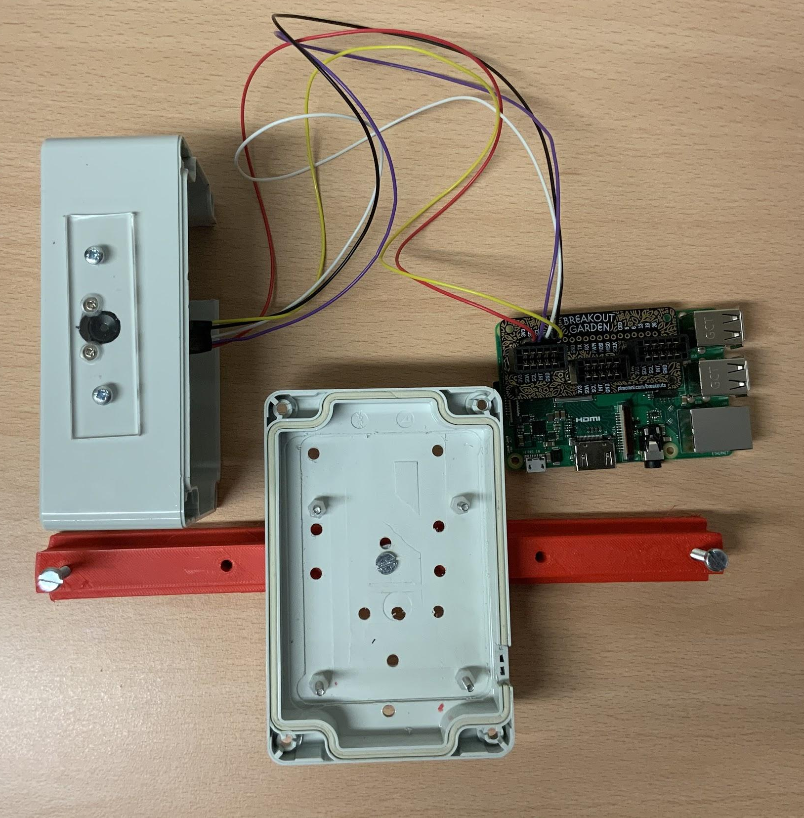
Thermal Camera Housing
Thermal Camera
Raspberry Pi 3
Slot Liner

Slide 26
Experimentation
Thermal camera rig is enclosed to avoid powder damaging components
Powered by a single LiPo battery for 24hr single use
Scripted to run continuously and capture live thermal image data to log file structure
After run, data can be extracted from SD card and processed offline

Slide 27
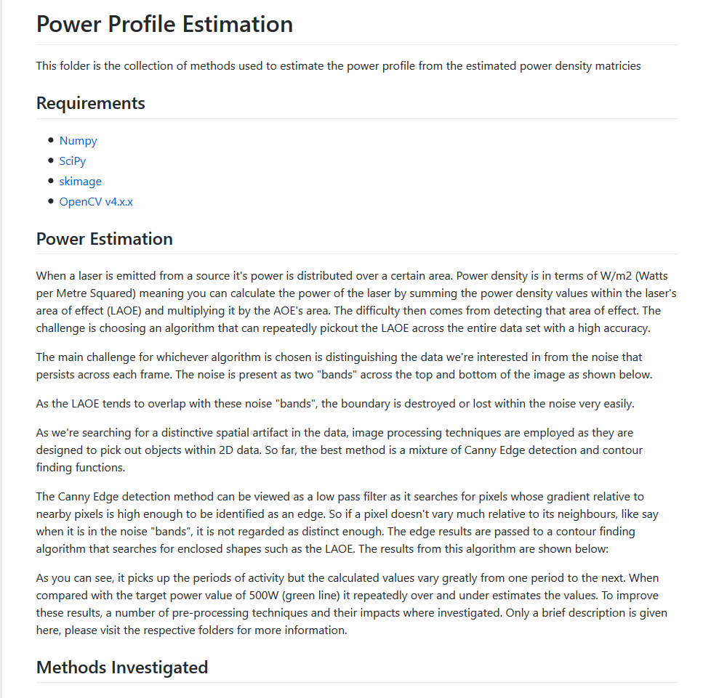
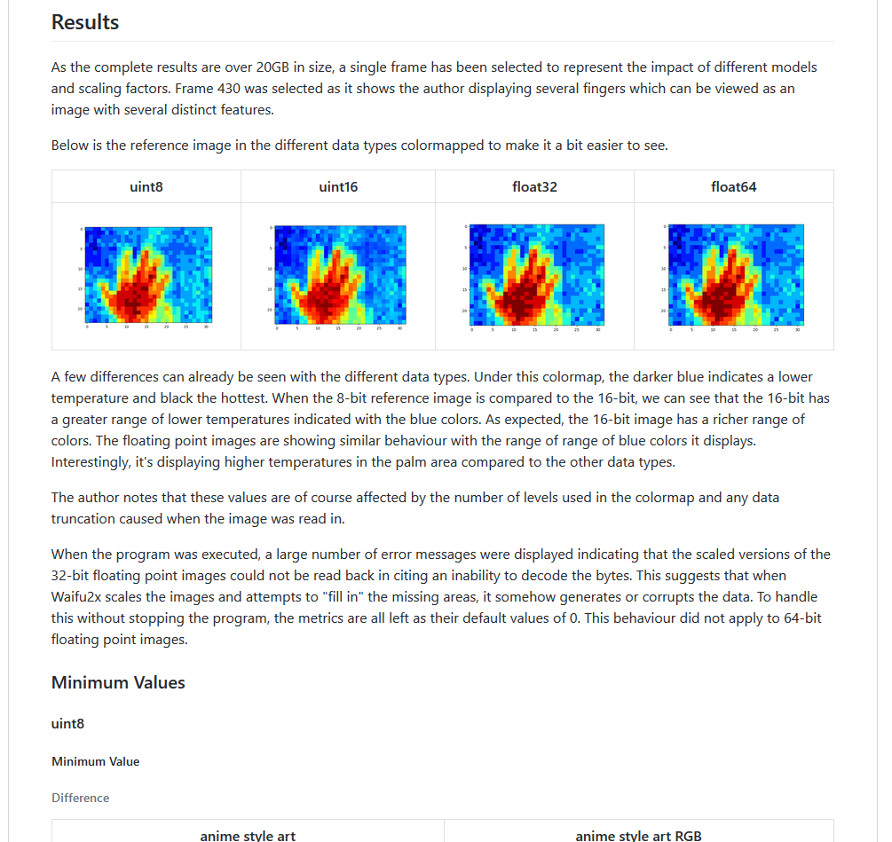
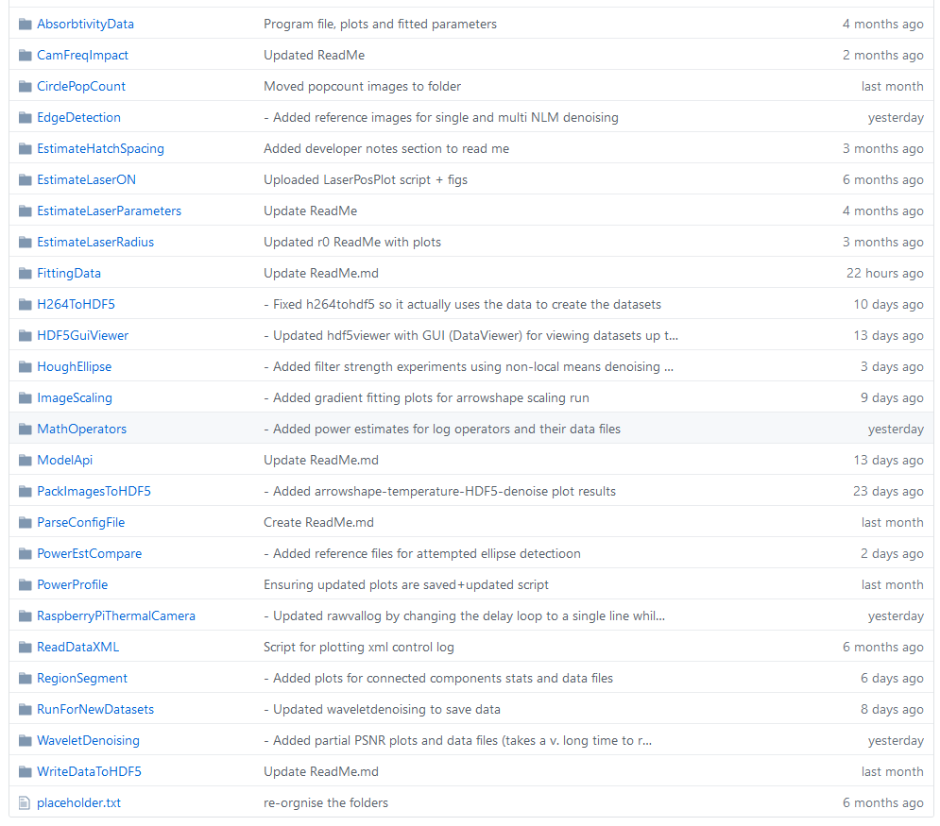
Documentation + Results
Documented in GitHub repository

